Slide 1

Web technologies using java
Course 8 – JDBC

Slide 2
agenda
JDBC OVerview
Jdbc Architecture
Connecting to a database
Working with queries
Closing database resources
Jdbctemplate

Slide 3
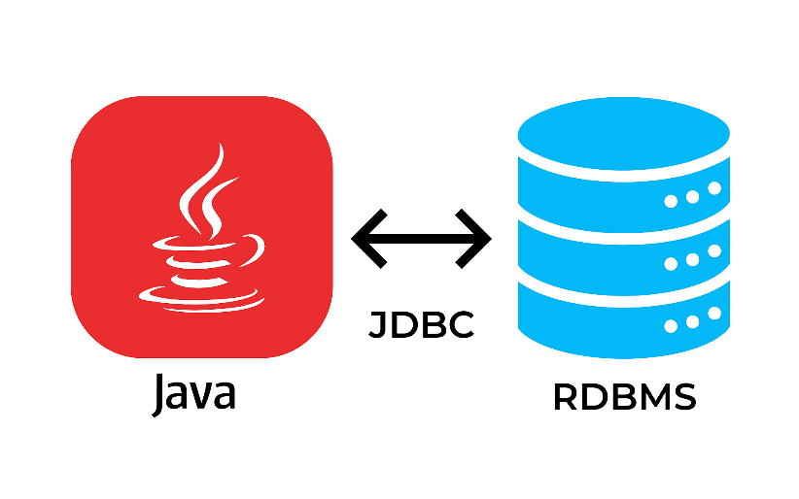
Jdbc overview
There are two main ways to access a relational database from Java:
Java Database Connectivity Language (JDBC): accesses data as rows and columns
Java Persistence API (JPA): accesses data through Java objects using a concept called object‐relational mapping (ORM)
JDBC allows you to construct SQL statements and embbed them inside Java API calls

Slide 4
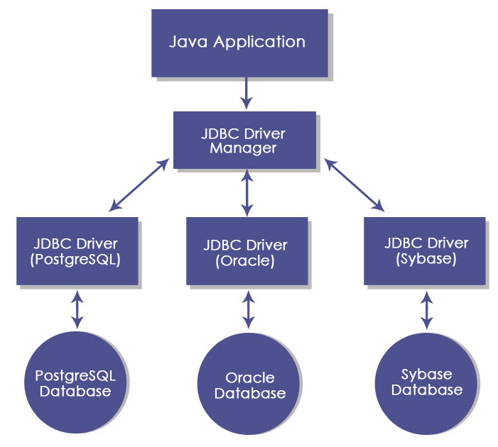
Jdbc architecture
JDBC API provides a shared language through which Java applications can talk to database engines
JDBC driver is the set of classes that implement the JDBC interfaces for a particular database engine

Slide 5
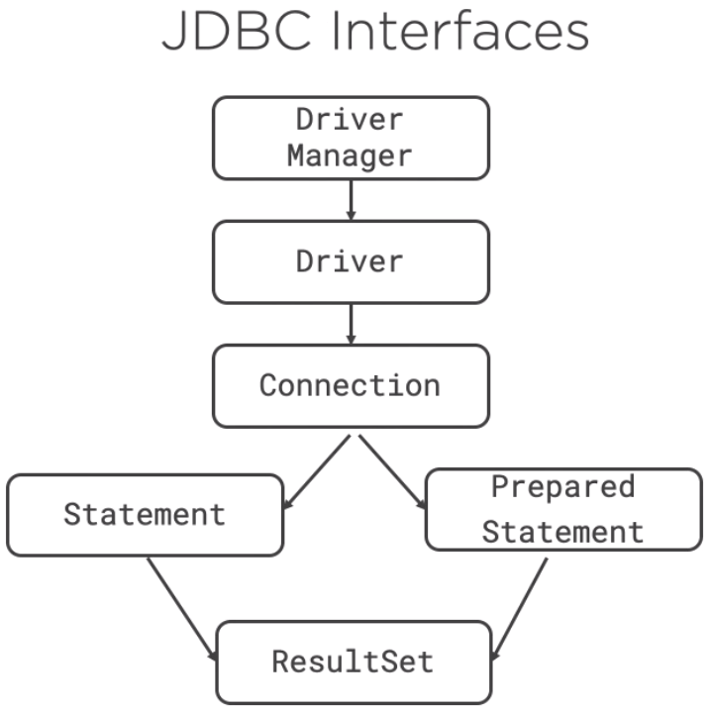
Jdbc architecture
JDBC interfaces (contracts):
Driver: establishes a connection to the database
Connection: sends commands to a database
Statement: executes a SQL query
PreparedStatement: executes a SQL query
CallableStatement: executes commands stored in the database
ResultSet: reads results of a query
All database interfaces are in the package java.sql

Slide 6
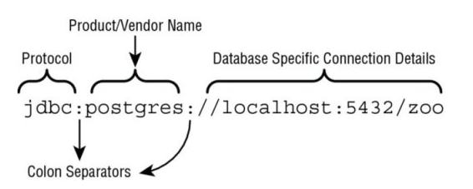
Connecting to a database
steps needed in order to establish a connection to a database:
define the JDBC url
create a Connection based on DriverManager or DataSource
in SpringBoot applications, the configuration of a DataSource can be done:
using a DataSource bean
using certain properties in application.properties (recommended)
NOTE: A DataSource has more features than DriverManager (it can pool connections or store the database connection information outside the application)

Slide 7
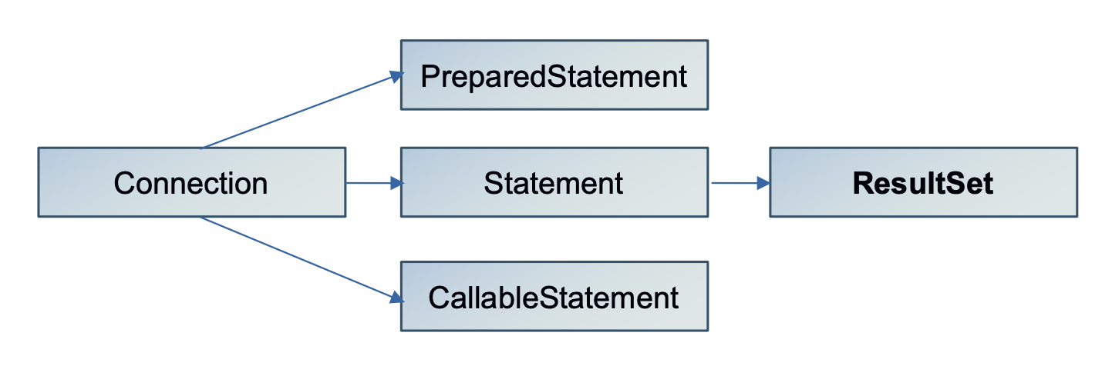
Working with queries

Slide 8
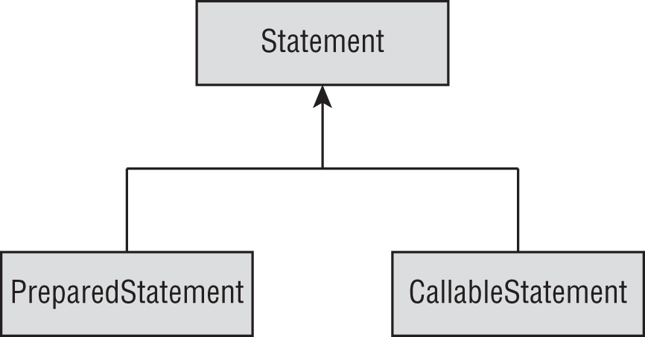
Working with queries
Statement or PreparedStatement: used to run queries
CallableStatement: used to run stored procedures
recommendation is to use PreparedStatement:
performance: it figures out a plan to run the SQL well and remembers it
security: protects against an attack called SQL injection
readability: no need to use string concatenation in building a query string with lots of parameters
PreparedStatement uses parameter binding:
through parameter position (index)
through parameter name

Slide 9
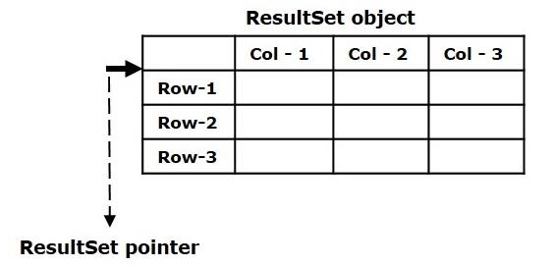
Working with queries
ResultSet: provides a collection with all records retrieved from a select query on the database
You can use a loop to iterate through all records
You can access values using the index or the column name

Slide 10
Closing database resources
JDBC resources are expensive to create. Not closing them creates a resource leak that will eventually slow down your program
resources must be closed in the right order, to avoid resource leaks and exceptions
closing a JDBC resource should close any resources that it created:
closing a Connection also closes PreparedStatement / CallableStatement and ResultSet
closing a PreparedStatement / CallableStatement also closes the ResultSet

Slide 11
JDBCTEMplate
Spring support for working with JDBC
Used for creating connections, executing queries and retrieving results

Slide 12
bibliography
Spring in Action, by Craig Walls
Spring REST, by Balaji Varanasi, Sudha Belida
Database Programming with JDBC and Java, George Reese

Slide 13

Q&A

Slide 14
THANK YOU
DANIELA CIUPERCA

